Slide 1
2018 North County Housing Summit

Slide 2
Ray Major
Chief Economist, San Diego Association of Governments

Slide 3
Preliminary Regional Growth Forecast
North County Housing Summit - July 19, 2018

Slide 4
How is the Regional Growth Forecast Used?
2050 Regional Plan Transportation Network
Regional Sustainably Communities Strategy land use pattern
San Diego County Water Authority facility planning
Local planning efforts
San Diego County Health and Human Services research efforts
Notes:
Why we do the growth forecast
The purpose of the forecast

Slide 5
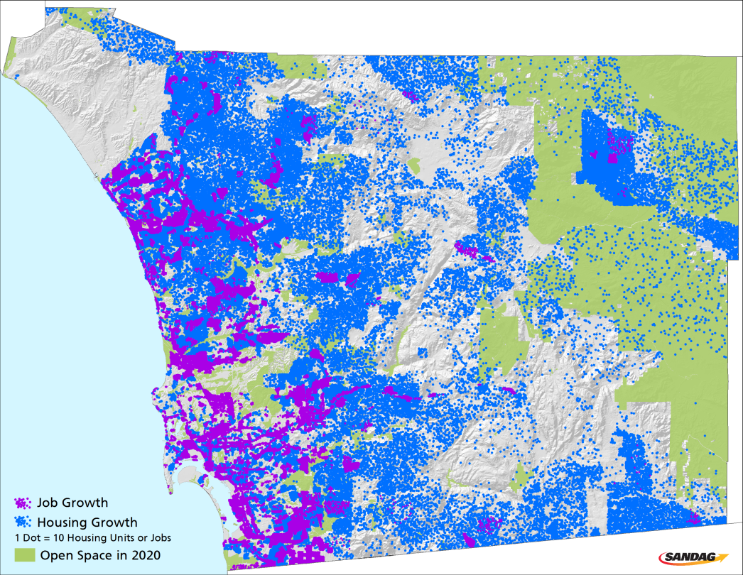
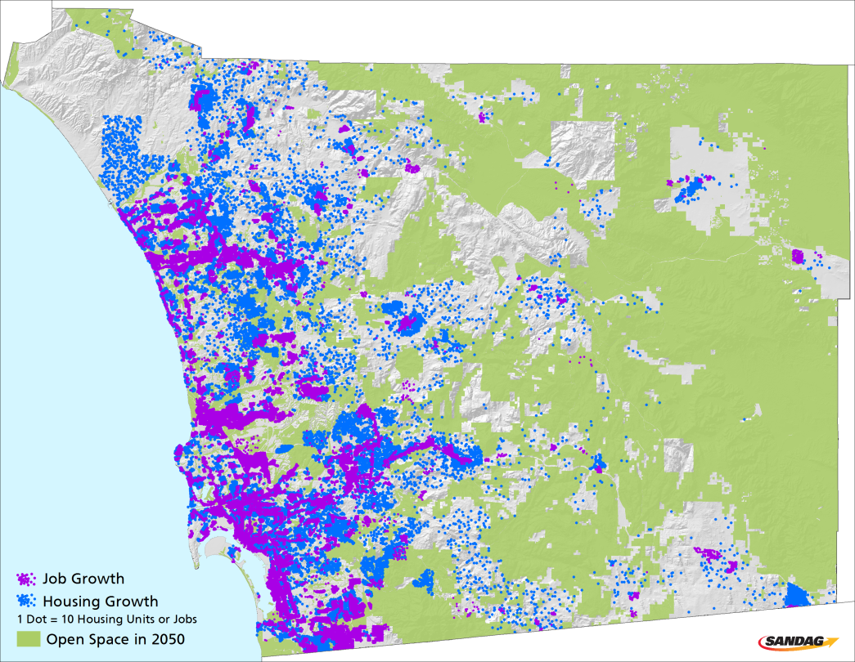
The region’s evolution
Comparing Growth Projected in 1999 and 2018
2020: 3.9 million pop
2050: 4.0 million pop

Slide 6
Regional Demographic Growth Forecast

Slide 7
Regional Growth Forecast
Growth (2017-2050) = 700,000
Growth (2017-2050) = 360,000
Growth (2017-2050) = 433,000

Slide 8
Department of Finance Population Projections
Source: CA Department of Finance, 2017 Series Projections

Slide 9
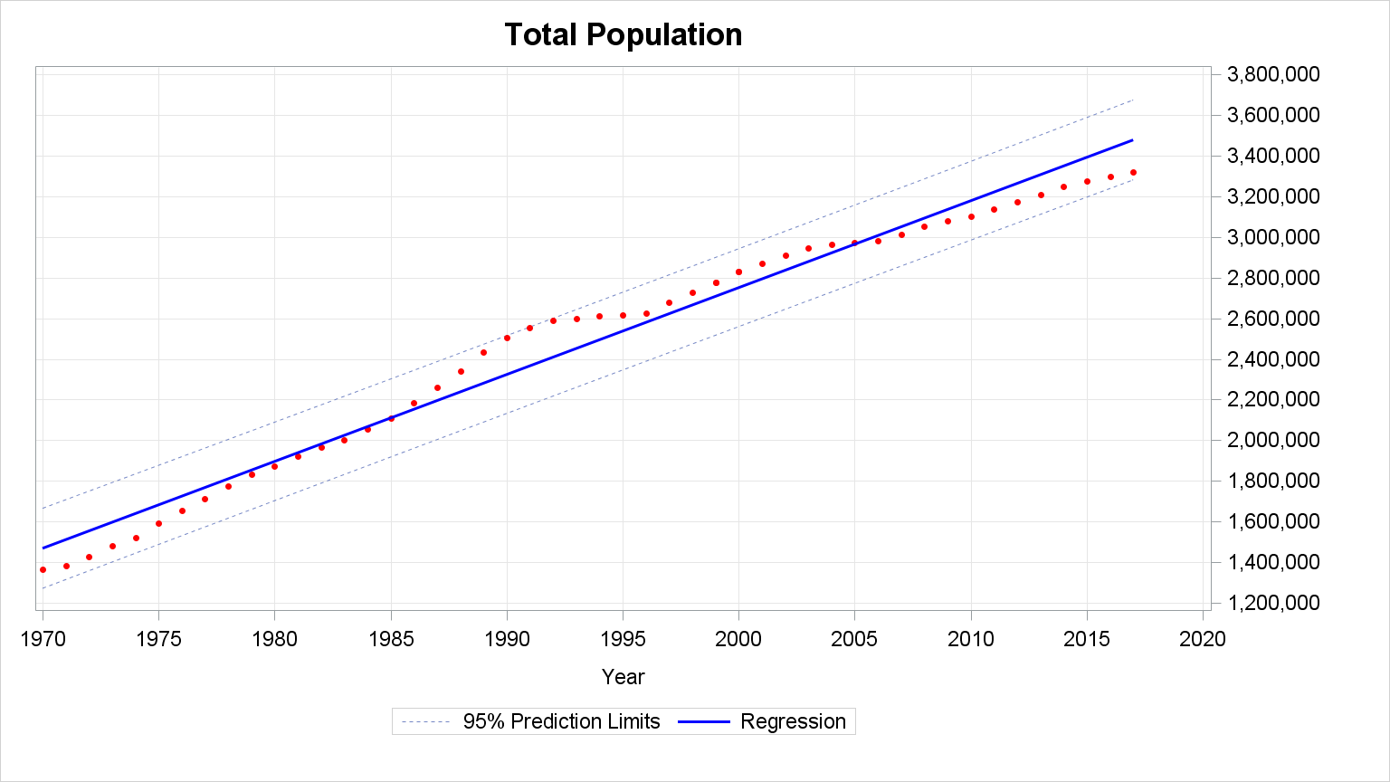
Historical Population Variation (1970-2017)
+/- 8%

Slide 10
Total Population Forecast Range
Range
4.3 mil
4.0 mil
3.7 mil

Slide 11
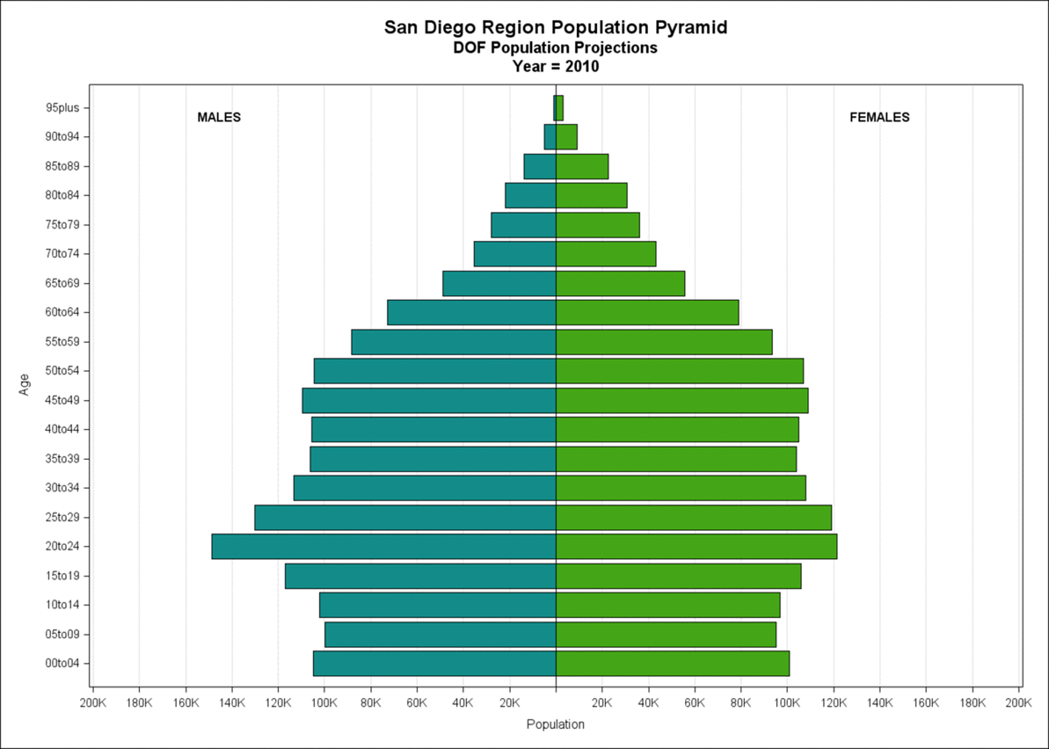

Slide 12
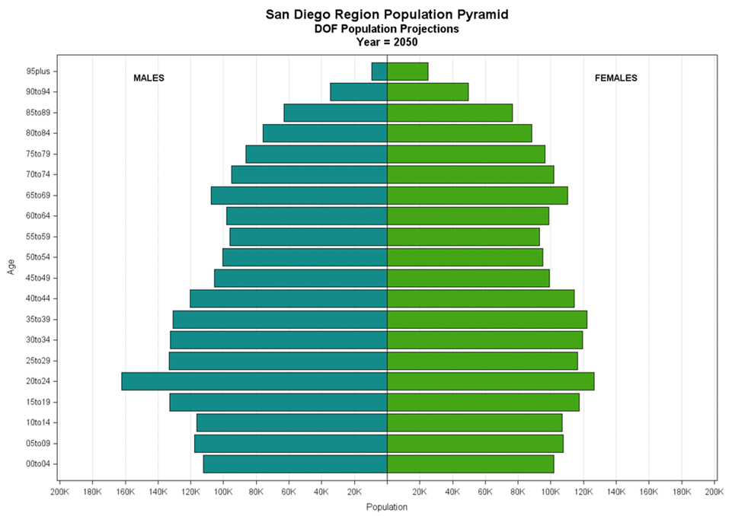

Slide 13
Race and Ethnic Composition
Note: All race groups are “Non-Hispanic”; All race/ethnicity groups are mutually exclusive
Source: California Dept. of Finance Population Projections, 2017

Slide 14
Components of Change to the Population
Source: California Dept. of Finance Population Projections, 2017
Notes:
According to the DOF projections, population increase in the region will be due to natural increase (the numbers of births minus the number of deaths) until 2031, after that point, due to lower fertility and higher survival, the increase to the population in the region will be due to in-migration to the region—both from other countries and from other places in the CA and the US.

Slide 15
Projected Population Growth in California by County—2016 to 2050
Source: California Dept. of Finance Population Projections, 2017

Slide 16
San Diego and North County
San Diego North County
Population: 3, 366,703 1,182,529
% Minority: 54.1% 49.3%
Population 2050: 4,004,674 1,290,528
Growth: 18.9% 9.1%
% Minority 2050: 61.7% 58.9%
Median Age: 36 37
Median Age 2050: 40 41
Median HH Income: $66,460 $72,634
Top Employment
Sectors: Health Care/SS Manufacturing
Professional Health Care/SS
Hospitality Retail
Retail Hospitality
Notes:
North County is expected to grow less by 2050 than the County as a whole, but experience more of a demographic shift. North County retains its modest income advantage in 2050: $71,493 to $77,155.

Slide 17
Assumptions & Preliminary Results

Slide 18
Projections
Input from local jurisdictions
Input from expert review
National and local trends

Slide 19
Expert Review Panel—Institutions Represented
March 2017 Panel— Data and Methods
February 2018—Assumptions
California Department of Finance
Center for Continuing Study of the California Economy
Economics & Politics, Inc.
National University
Pt. Loma Nazarene University
San Diego State University
San Francisco Federal Reserve
UC San Diego
University of Florida
University of San Diego
WSP Parsons Brinkerhoff
California Department of Finance
University of San Diego
Southern California Association of Governments
London/Moeder Advisors

Slide 20
Key Regional Assumptions
Population grows older and we live longer;
81 percent of the total pop growth will be in age 65+
Median age increases from 35 to 40
Average household size decreases as population ages
Acknowledge Second Homes and Vacation Rentals as “un-occupiable” units
~ 57,000 units
Healthy Vacancy Rate (4% effective rate long term)
Capacity for first time homebuyers
Permits residents to move between units
Moderates housing and rental prices

Slide 21
Age Composition of the Population
81% of the population growth is to ages 65+
Notes:
The population will grow by about 700,000 persons between 2017 and 2050, of this growth, 81% or 565,000 will be to ages 65+
In 2016 those ages 65+ were about 17% of the population, by 2050 this group will comprise 34% of the population
From 2016 CPS data (a Census Bureau survey): Nationally, the average household size for households headed by someone age 65+ is about 1.8 PPH, households headed by someone ages 20 to 34 is about 2.7 PPH and those headed by someone ages 35 to 44 is about 3.3.
This is due to living with roommates in your 20’s and family size increases (getting married, having kids) in your 30’s-40’s.

Slide 22
Household Size Declines with Median Age
Regional Forecast, 2050 (2.56)
Source: Census 2010, Summary File 1
Notes:
Oldest County: Sumter County, FL (near Orlando)
Dots on the furthest right indicate counties in FL, NM, AZ
Furthest to the left are places in UT, AK, and a handful of counties dominated by a university
Counties with ~39 years old median age in 2010: Worcester County, MA (outside Boston, 2.55 PPH); Broward County, FL (Ft. Lauderdale, 2.52); Baltimore County, MD (2.48)

Slide 23
Healthy Housing Market Vacancy Rate
State (HCD) uses a 5% vacancy rate
Expert Review Panel recommended a 5% vacancy rate
Board of Directors targets a 4% long-term vacancy rate
Notes:
Board of Directors, after considering the estimated historical “net” vacancy rate, votes to target a 4% vacancy rate
Detailed data not available, but decennial census data suggests SD long-term vacancy rate about 3%
Research in other metro areas considers 6-7% to be a “healthy” vacancy rate (Boston area research from Northeastern Univ.)

Slide 24
Housing Need Forecast
Range
1.8 mil
1.7 mil
1.6 mil
1.2 mil

Slide 25
Residential Permits Issued San Diego County
Carmel Valley, Poway/Rancho Bernardo, Eastlake
Mira Mesa, Scripps Ranch
Penasquitos, North Coast, San Marcos
11,628: annual average units needed 2000-2017 to support population growth
Penasquitos, Scripps Ranch, Eastlake San Luis Rey
53,851
unit shortage
Source: Real Estate Research Council, SD Regional Chamber
25
Notes:
This is a historical graph of how many permits were issued each year between 1970-2017 and where that building took place. In the early 70s, Mira Mesa and Scripps Ranch was built out, while in the late 70s, the buildout was mostly in Penasquitos, the North Coastal area, and San Marcos and so on.
Currently, there isn’t a lot of free land to support the building of 30-40,000 units like what took place in the 70s and 80s. Now, we have to focus on infill and densifying the areas that already have been built.
In 2017, just 9,580 residential permits were issued. Over the past decade, the average was 7,415 units per year.
In order to support the current population growth, we would need to have built 11,628 units per year, on average, since 2000.
As you can see by this gap below the green average line, we are currently at a 53,851 unit shortfall. If we don’t want to continue to have this housing crisis for the next 30 years, we will need to build an additional 509,000 units to support the population growth.

Slide 26
Residential Permits Issued San Diego County
Carmel Valley, Poway/Rancho Bernardo, Eastlake
Mira Mesa, Scripps Ranch
Penasquitos, North Coast, San Marcos
11,628: annual average units needed 2000-2017 to support population growth
Housing units needed
2017-2050
Penasquitos, Scripps Ranch, Eastlake San Luis Rey
53,851
unit shortage
Source: Real Estate Research Council, SD Regional Chamber
26
Notes:
This is a historical graph of how many permits were issued each year between 1970-2017 and where that building took place. In the early 70s, Mira Mesa and Scripps Ranch was built out, while in the late 70s, the buildout was mostly in Penasquitos, the North Coastal area, and San Marcos and so on.
Currently, there isn’t a lot of free land to support the building of 30-40,000 units like what took place in the 70s and 80s. Now, we have to focus on infill and densifying the areas that already have been built.
In 2017, just 9,580 residential permits were issued. Over the past decade, the average was 7,415 units per year.
In order to support the current population growth, we would need to have built 11,628 units per year, on average, since 2000.
As you can see by this gap below the green average line, we are currently at a 53,851 unit shortfall. If we don’t want to continue to have this housing crisis for the next 30 years, we will need to build an additional 509,000 units to support the population growth.

Slide 27
North County Housing
San Diego North County
Housing Units: 1,211,899 426,427
Housing Units 2050: 1,645,314 537,251
Housing Growth: 35.8% 26.0%
Population Growth: 18.9% 9.1%
Notes:
Note that housing is going to grow much faster than pop; in SD almost twice as fast, in North County almost three times as quickly. (Warning: the numbers on this graph indicate a 433k increase in housing; the summary slide says 452k increase.

Slide 28
Jobs Forecast
Range
1.4 mil

Slide 29
Commuters into San Diego County
1990: ~17,000 from LA, OC, SB, and Riverside
2000: ~32,000 most of the growth from Riverside
2010: ~62,000 (4.3% of all jobs in SD)
66% from Riverside County
By 2050: ~127,000 (7% of all jobs in SD)
Over 80% from Riverside County

Slide 30
Commuters into San Diego County
1990: ~17,000 from LA, OC, SB, and Riverside
2000: ~32,000 most of the growth from Riverside
2010: ~62,000 (4.3% of all jobs in SD)
66% from Riverside County
By 2050: ~127,000 (7% of all jobs in SD)
Over 80% from Riverside County
About 25% of employed North County residents work outside SD County, and about 25% of North County jobs are filled by non-SD County residents.

Slide 31
Regional Growth Forecast
Growth (2017-2050) = 700,000
Growth (2017-2050) = 360,000
Growth (2017-2050) = 452,000

Slide 32
Preliminary Capacity and Projected Housing Need
RHNA 6th Cycle
General Plan Maximum Capacity (800,000)
Draft Regional Forecast (509,000)
2016 Jurisdiction
Initial Projected Capacity (371,000)
138,000
Notes:
Decreasing persons per household
Healthy vacancy rate
Excludes second homes and vacation rentals from available housing stock

Slide 33
Smart Growth Concept Map Implementation
Assuming Smart Growth Opportunity Area minimum residential place type densities (minus existing housing and local identified capacity) could provide additional housing units:
Metropolitan Center (75 du/acre) 57,000
Urban Center (40 du/acre) 95,000
Town Center (20 du/acre) 97,000
M-Use Transit Center (25 du/acre) 117,000
Community Center (20 du/acre) 102,000
Rural Village (10.9 du/acre) 23,000
Notes:
Three alternative land use scenarios introduced in SR13 to test GHG reduction potential

Slide 34
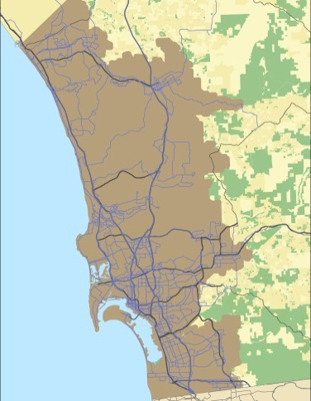
Accessory Dwelling Units in Urbanized Area
Assuming accessory dwelling units on single-family parcels of 5,000 square-feet or larger in urbanized area could provide:
100% 388,000 units
50% 194,000 units
20% 77,000 units
10% 38,000 units
5% 20,000 units
Notes:
Three alternative land use scenarios introduced in SR13 to test GHG reduction potential

Slide 35
Regional Housing Needs Assessment (RHNA)

Slide 36
Draft RHNA Determination
Income Category | Housing Unit Need | Percent
Very Low | 42,332 | 24.7%
Low | 26,627 | 15.5%
Moderate | 29,734 | 17.3%
Above Moderate | 72,992 | 42.5%
Total Housing Units | 171,685 | 100.0%
Notes:
Draft RHNA Determination prepared by the Department of Housing and Community Development (HCD)
Sixth housing element cycle – June 30, 2020 to April 15, 2029
Calculations using California Department of Finance (DOF) and American Community Survey (ACS) data
171,685 units in sixth housing element cycle
Summer 2018 – TWG/RPC/Board of Directors
Present final RHNA Determination
Begin discussing methodology for RHNA Plan

Slide 37
2017 Regional Housing Progress Report

Slide 38
RHNA Progress
Share of New Housing Units in the San Diego Region by Income Category
January 1, 2010 – December 31, 2016 (7 years)
Income Level | Very-Low | Low | Moderate | Above-Moderate | Total for all categories
Total Housing Use Permitted | 2,868 | 3,746 | 2,075 | 42,025 | 50,714
RHNA Goal (5th Cycle, 11 years) | 36,450 | 27,700 | 30,610 | 67,220 | 161,980
Percent of Goal Produced | 7.9% | 13.5% | 6.8% | 62.5% | 31.3%
Units Left to Permit | 33,852 | 23,954 | 28,535 | 25,195 | 111,266

